Slide 1


Expert Finder
RAG con datos de MS Graph user profile

Slide 2



Luis Mañez
Chief Architect @ ClearPeople
Co-founder @ RocketMind Academy
MS MVP M365 Development
Ruben Toribio
M365 Architect / Full Stack & IA Developer @ DNV
Co-founder @ RocketMind Academy

Slide 3


Slide 4
01
RAG Pattern

Slide 5
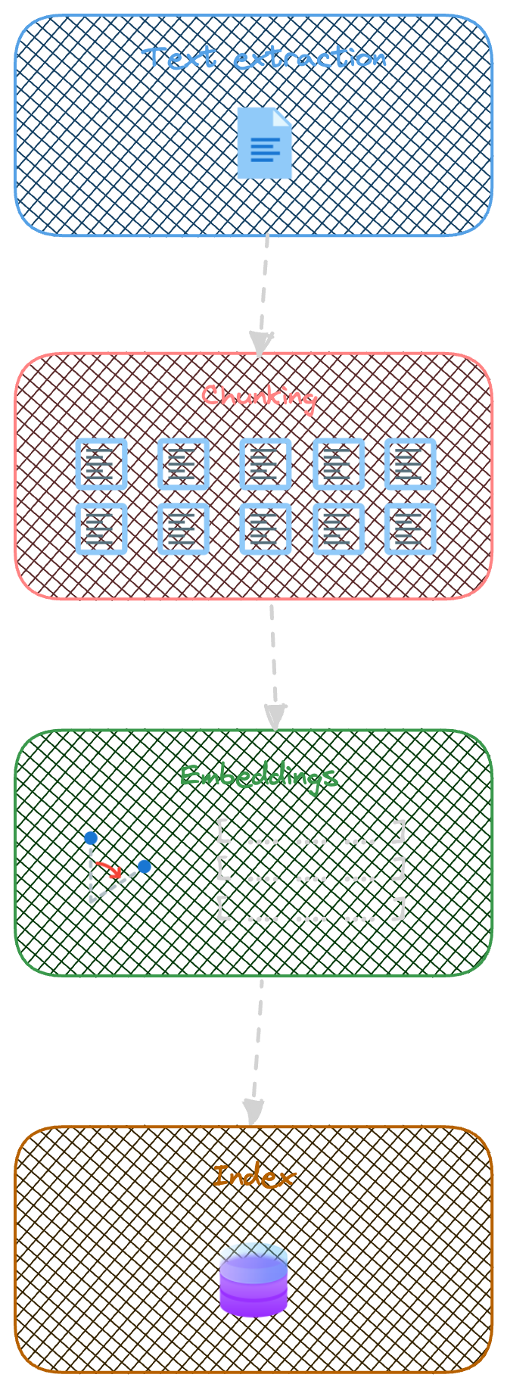
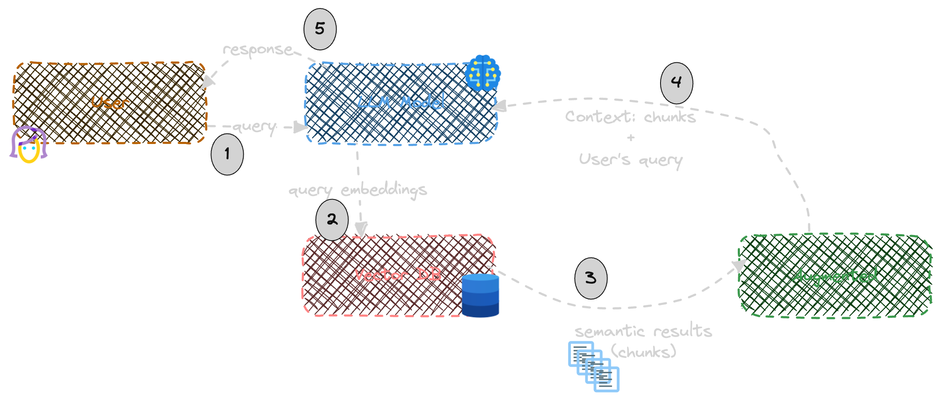
Indexing
Retrieval – Augmented - Generation

Slide 6
02
KernelMemory

Slide 7
Kernel Memory
OpenSource library lead by Microsoft
https://github.com/microsoft/kernel-memory
Integrated with Semantic Kernel
Can run serverless or as a service
Data Formats
Vector Databases
File storage
LLMs
Web pages
PDF
Images
Word
PowerPoint
Excel
Markdown
Text
JSON
HTML
Azure AI Search
Elasticsearch
MongoDB Atlas
Qdrant
Redis
… and more
Disk
Azure Blobs
MongoDB Atlas
In memory (volatile)
Azure OpenAI
OpenAI
LlamaSharp
Anthropic

Slide 8
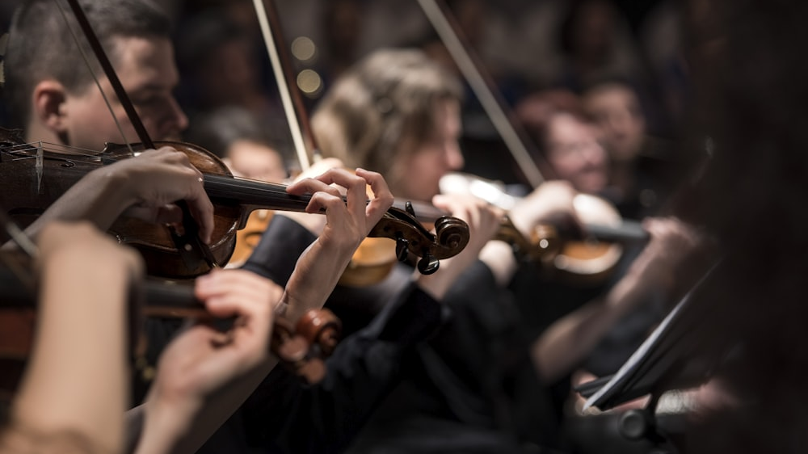
Demo time!

